Slide 1
Introduction to Programmable Logic Controllers
(PLC's)

Slide 2
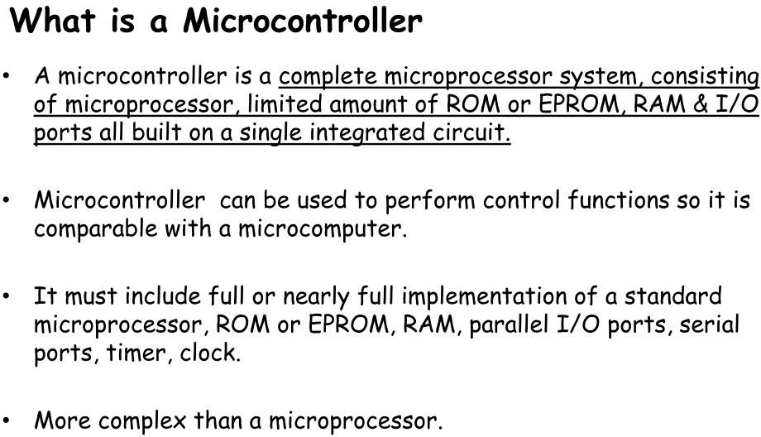

Slide 3
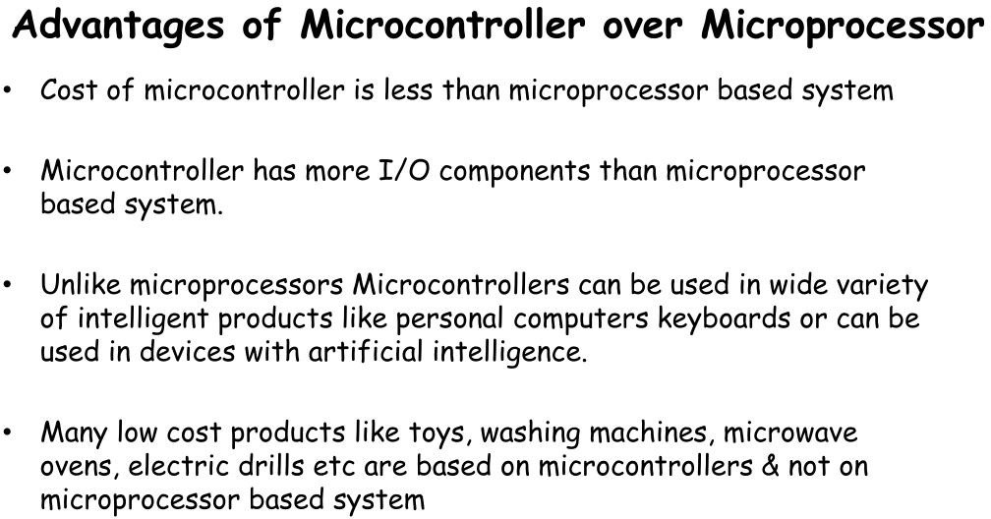

Slide 4
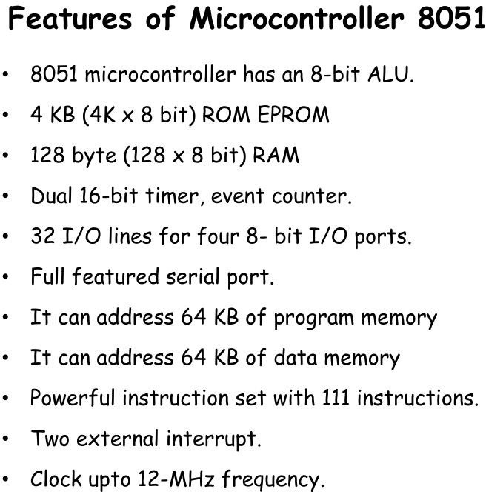

Slide 5
The Need for PLCs
Hardwired panels were very time consuming to wire, debug and change.
GM identified the following requirements for computer controllers to replace hardwired panels.
Solid-state not mechanical
Easy to modify input and output devices
Easily programmed and maintained by plant electricians
Be able to function in an industrial environment

Slide 6
The PLCs: History
Introduced in the late 1960’s
Developed to offer the same functionality as the existing relay logic systems
Programmable, reusable and reliable
Could withstand a harsh industrial environment
They had no hard drive, they had battery backup
Could start in seconds
Used Ladder Logic for programming

Slide 7
A PLC is a specialized computer used to control machines and process.
It uses a programmable memory to store instructions and specific functions that include
On/Off control, timing, counting, sequencing, arithmetic, and data handling

Slide 8
Advantages of PLC Control Systems
Flexible
Faster response time ,Less and simpler wiring
Solid-state - no moving parts
Modular design - easy to repair and expand
Handles much more complicated systems
Sophisticated instruction sets available
Allows for diagnostics “easy to troubleshoot”
Less expensive

Slide 9
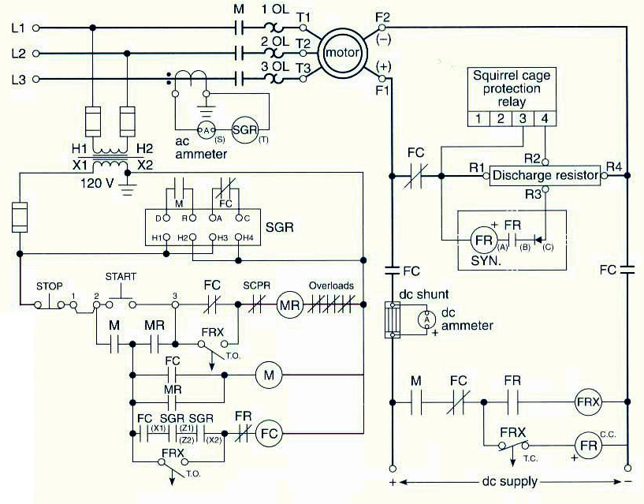
Advantages of a PLC Control System
Eliminates much of the hard wiring that was associated with conventional relay control circuits.
The program takes the place of much of the external wiring that would be required
for control of a process.

Slide 10
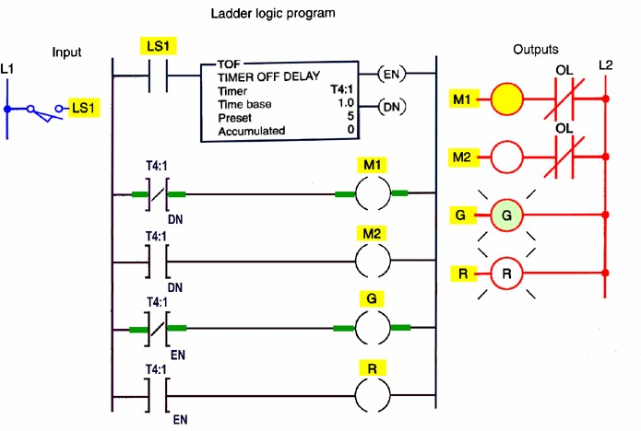
Advantages of a PLC Control System
Increased Reliability:
Once a program has been written and tested it can be downloaded to other PLCs.
Since all the logic is contained in the PLC’s memory, there is no chance of making a logic wiring error.
Conversely ......

Slide 11
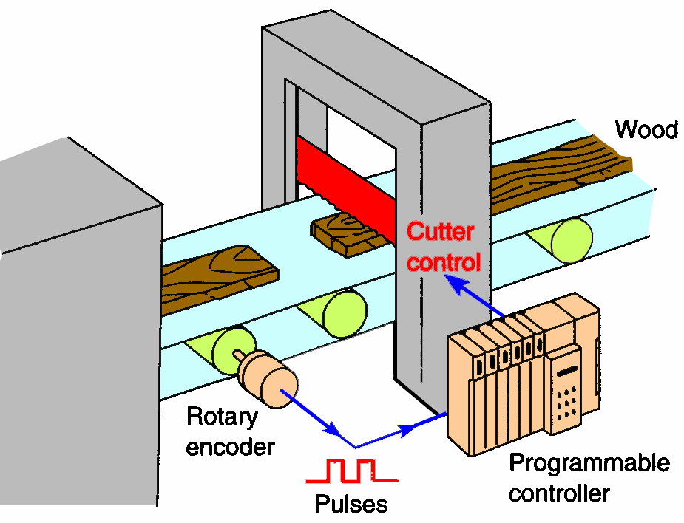
Advantages of a PLC Control System
More Flexibility:
Original equipment manufacturers (OEMs) can provide system updates for a process by simply sending out a new program.
It is easier to create and change a program in a PLC than to wire and rewire a circuit.
End-users can modify the program in the field.

Slide 12
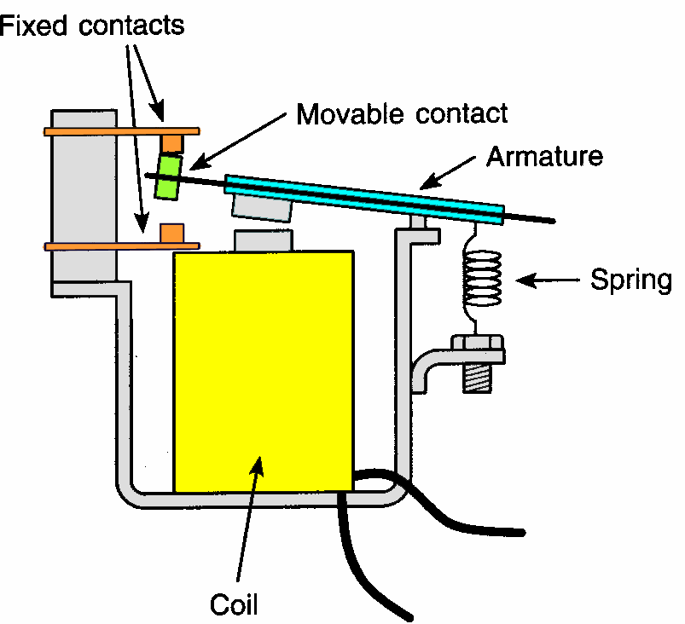
Advantages of a PLC Control System
Lower Costs:
Originally PLCs were designed to replace relay control logic. The cost savings using PLCs have been so significant that relay control is becoming obsolete, except for power applications.
Generally, if an application requires more than about 6 control relays, it will usually be less expensive to install a PLC.

Slide 13
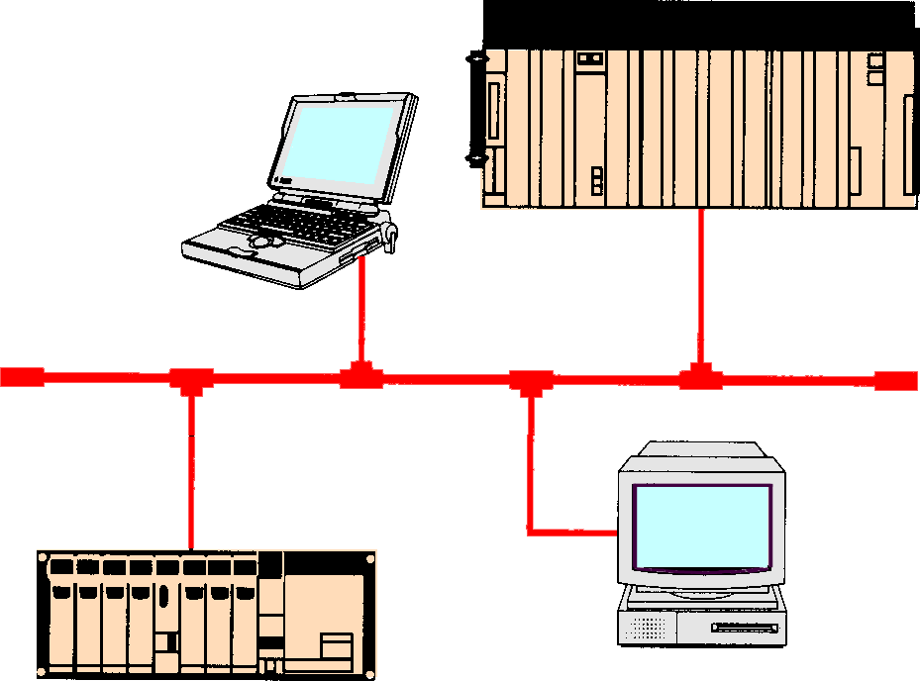
Advantages of a PLC Control System
Communications Capability:
A PLC can communicate with other controllers or computer equipment.
They can be networked to perform such functions as: supervisory control, data gathering, monitoring devices and process
parameters, and downloading and uploading of programs.

Slide 14
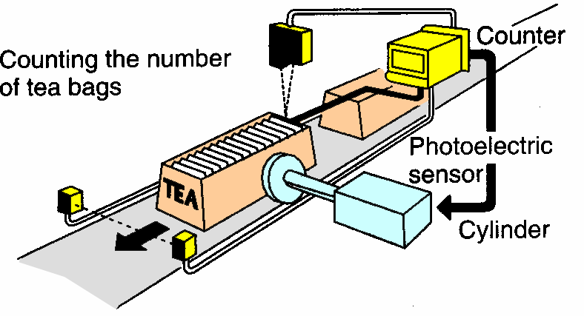
Advantages of a PLC Control System
Faster Response Time:
PLCs operate in real-time which means that an event taking place in the field will result in an operation or output taking place.
Machines that process thousands of items per second and objects that spend only a fraction of a second in front of a sensor require the PLC’s
quick response capability.

Slide 15
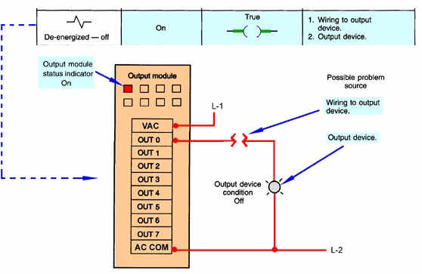
Advantages of a PLC Control System
Easier To Troubleshoot:
PLCs have resident diagnostic and override functions allowing users to easily trace and correct software and hardware problems.
The control program can be watched in real-time as it executes to find
and fix problems

Slide 16
PLC Architecture
An open architecture design allows the system to be connected easily to devices and programs made by other manufacturers.
A closed architecture or proprietary system, is one whose design makes it more difficult to connect devices and programs made by other manufacturers.
.

Slide 17
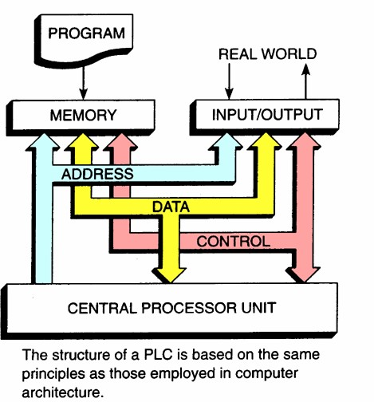
PLC Architecture

Slide 18
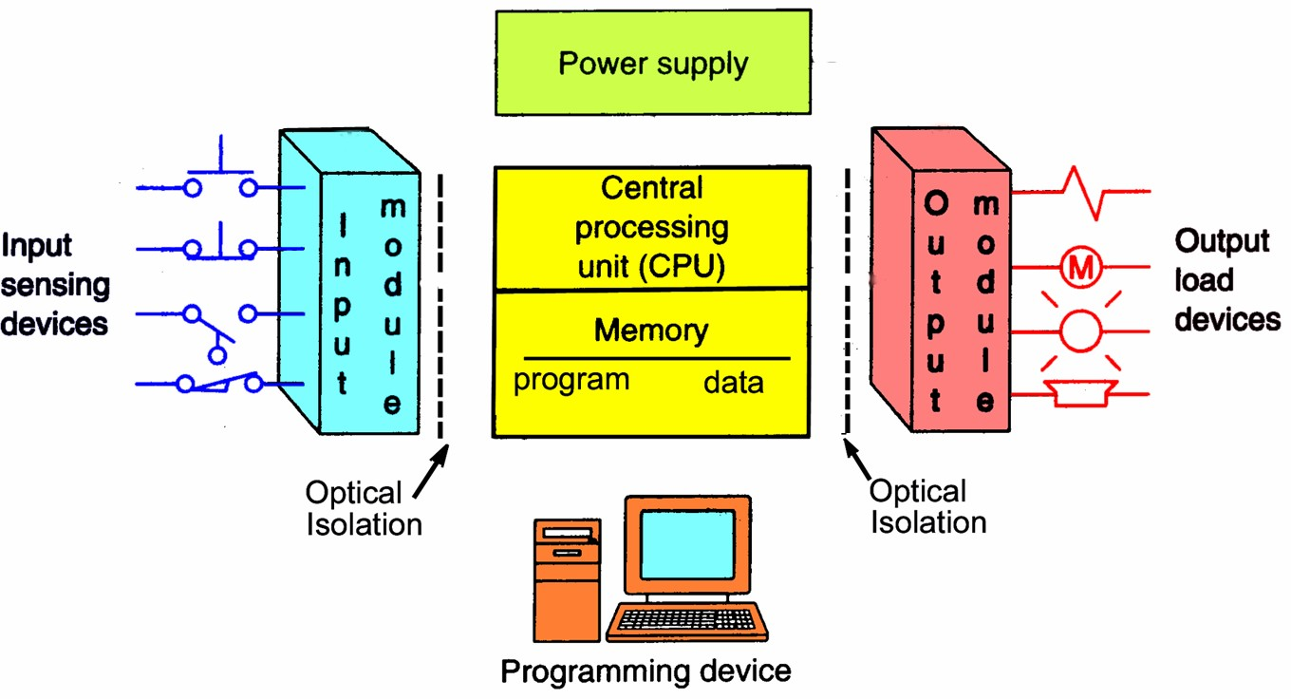
PLC System

Slide 19
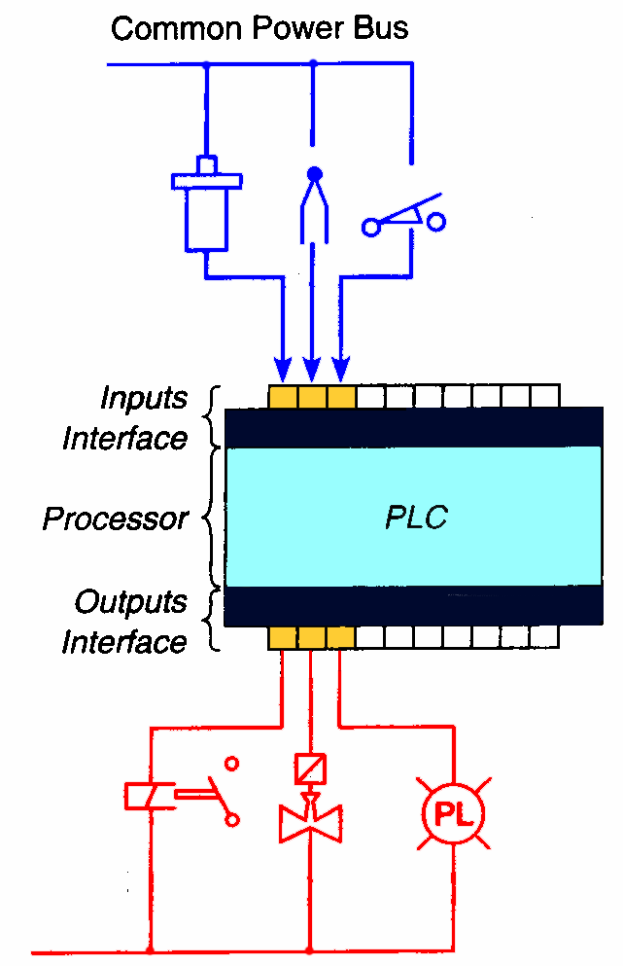
I/O Configurations
Fixed I/O
Is typical of small PLCs
Comes in one package, with no separate removable units.
The processor and I/O are packaged together.
Lower in cost – but lacks flexibility.

Slide 20
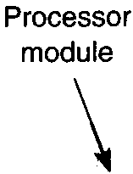
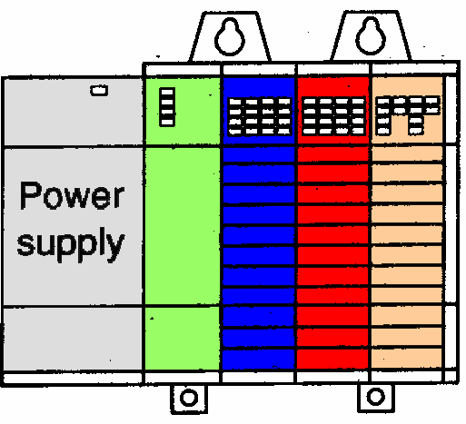


I/O Configurations
Modular I/O
Is divided by compartments into which separate modules can be plugged.
This feature greatly increases your options and the unit’s flexibility. You can choose from all the modules available and mix them in any way you desire.

Slide 21
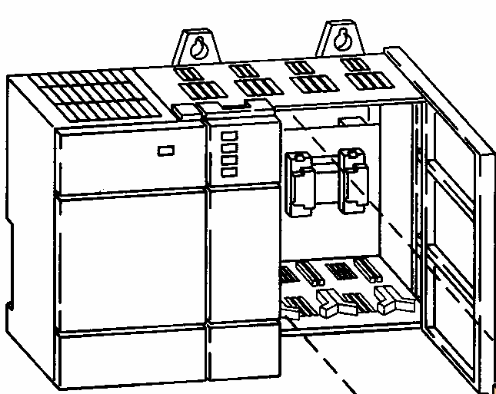
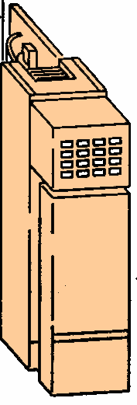

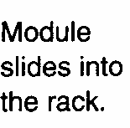
I/O Configurations
Modular I/O
When a module slides into the rack,
it makes an electrical connection with a series of contacts - called the backplane. The backplane is located at the rear of the rack.

Slide 22
Power Supply
Supplies DC power to other modules that plug into the rack.
In large PLC systems, this power supply does not normally supply power to the field devices.
In small and micro PLC systems, the power supply is also used to power field devices.

Slide 23
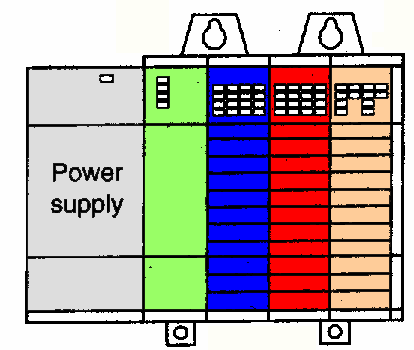

Processor (CPU)
Is the “brain” of the PLC.
Consists of a microprocessor for implementing the logic, and controlling the communications among the modules.
Designed so the desired circuit can be entered in relay ladder logic form.
The processor accepts input data from various sensing devices, executes the stored user program, and sends appropriate output commands to control devices.
Processor
Module

Slide 24
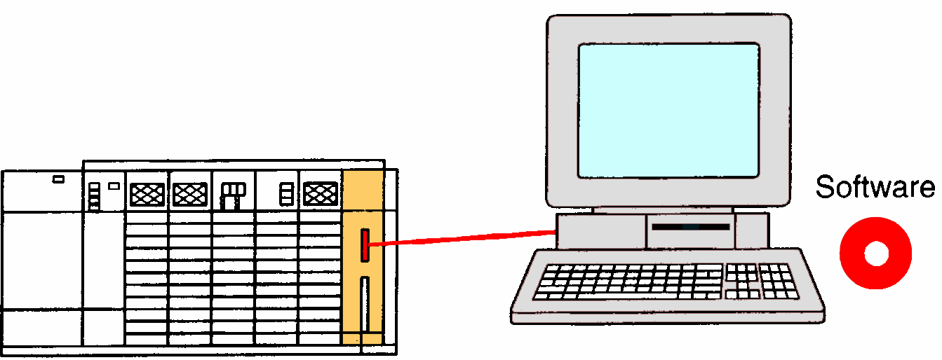
Programming Device
PC with appropriate software
A personal computer (PC) is the most commonly used programming device
The software allows users to create, edit, document, store and troubleshoot programs
The personal computer communicates with the PLC processor via a serial or parallel data communications link

Slide 25
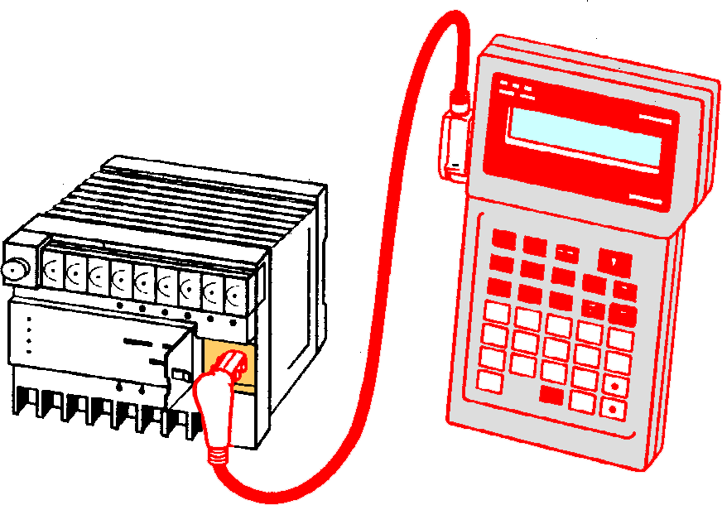
Programming Device
Hand-held unit with display
Hand-held programming devices are sometimes used to program small PLCs
They are compact, inexpensive, and easy to use, but are not able to display as much logic on screen as a computer monitor

Slide 26
Programming Device
Hand-held unit with display
Hand-held units are often used on the factory floor for troubleshooting, modifying programs, and transferring programs to multiple machines.

Slide 27
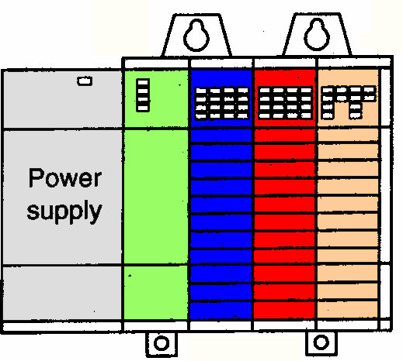
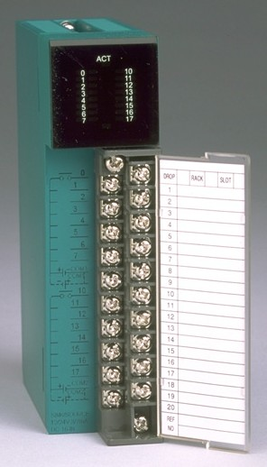
I/O Section
Consists of:
Input modules
Output modules.

Slide 28
Basic Module Types
Digital (discrete) output modules
Optical isolation provided
Relay, transistor or triac based
Transistor-based outputs may be
Current sourcing or
Current sinking
Digital (discrete) input modules
Optical isolation provided
Diode based
Current sinking, sourcing or both depending on device

Slide 29
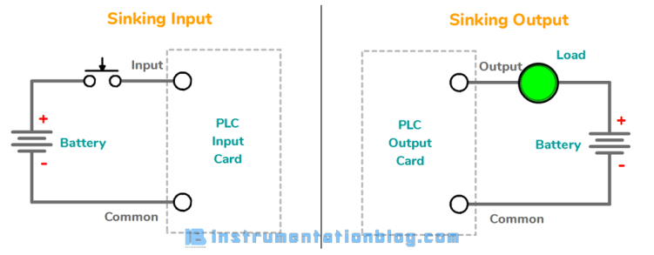
SINKING AND SOURCING
Sinking means internally connected with the common (-ve terminal)
input or output card wired internally to common is typically regarded as a sinking input or sinking output card.

Slide 30
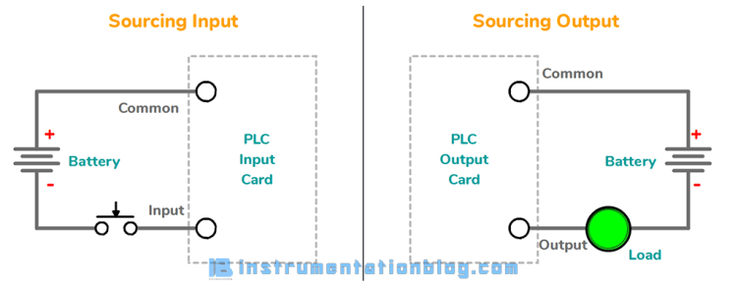
Sourcing means internally connected with the source (+ve terminal
input or output card connected directly to power, it’s typically called as sourcing input or sourcing output card.

Slide 31
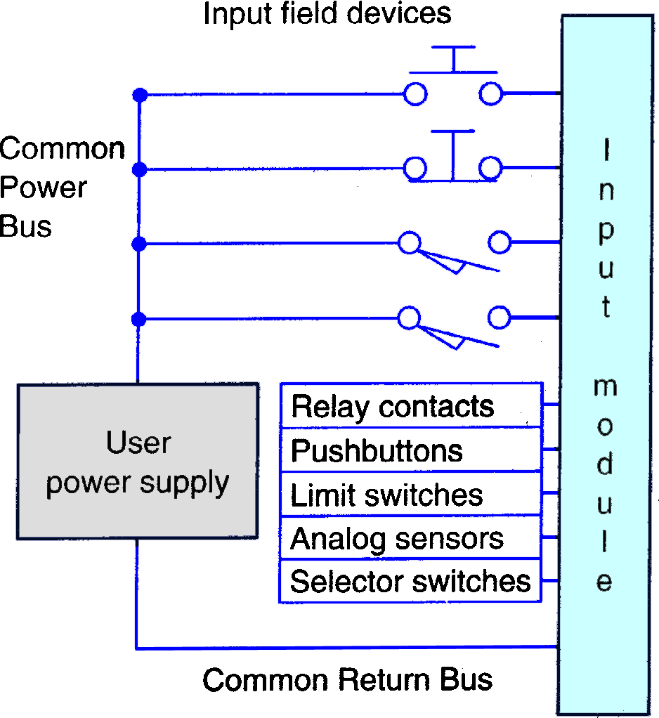
I/O Section
Input Module
Forms the interface by which input field devices are connected to the controller.
The terms “field” and “real world”are used to distinguish actual external
devices that exist and must
be physically wired into the system.

Slide 32
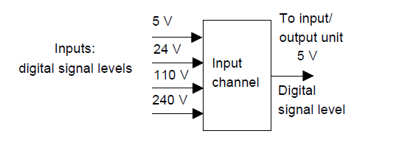
Input Module Levels

Slide 33
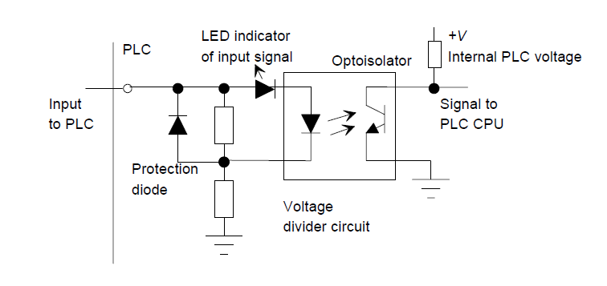
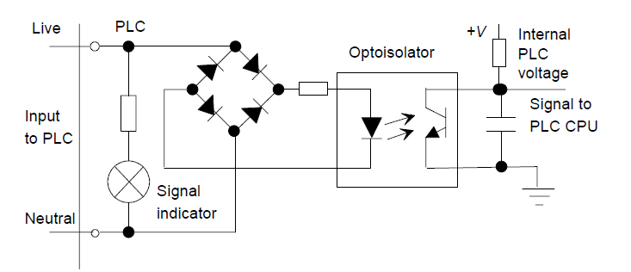
DC Input Unit
AC Input Unit

Slide 34
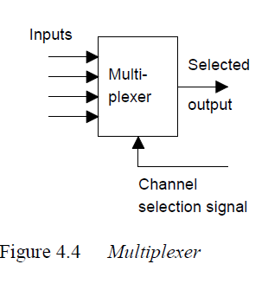
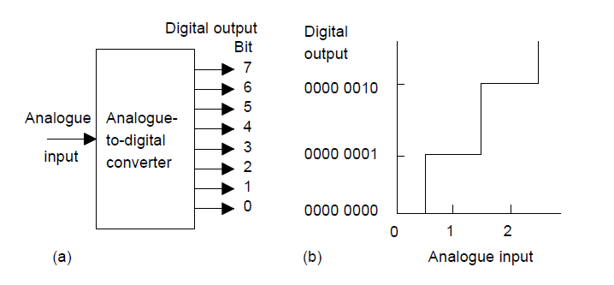
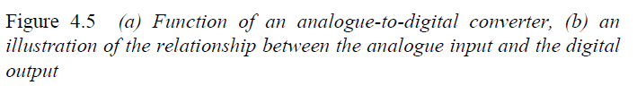
Multiplexer

Slide 35
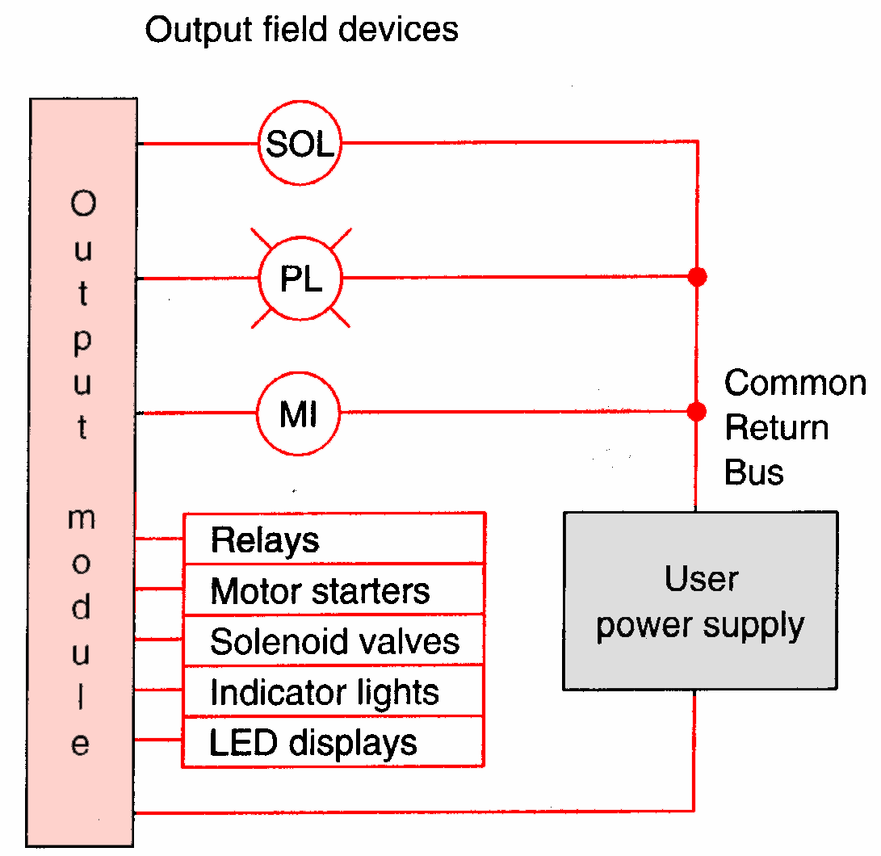
I/O Section
Output Module
Forms the interface by which output field devices are connected to the controller.
PLCs employ an optical isolator which uses light to electrical- ly isolate the internal components from the input and output terminals.

Slide 36
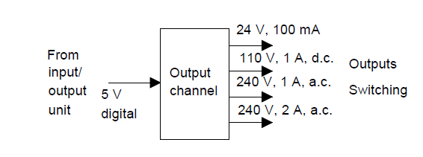
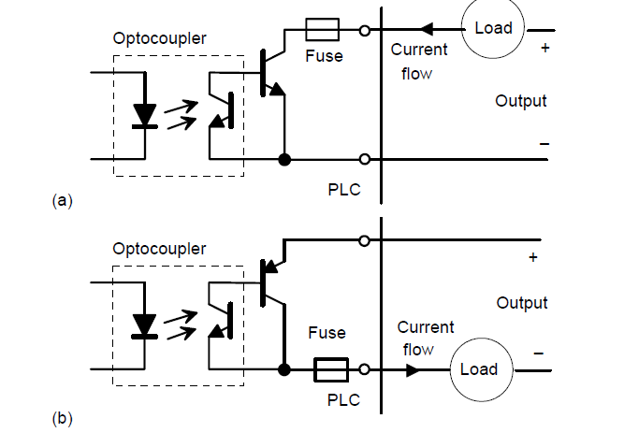
Output Module Levels
Transistor output

Slide 37
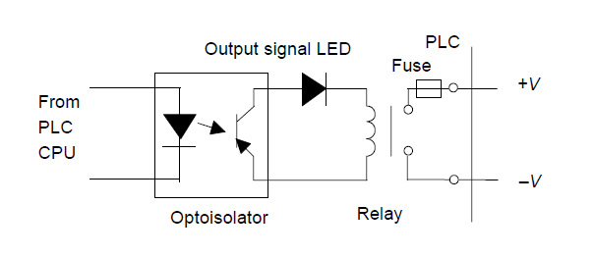

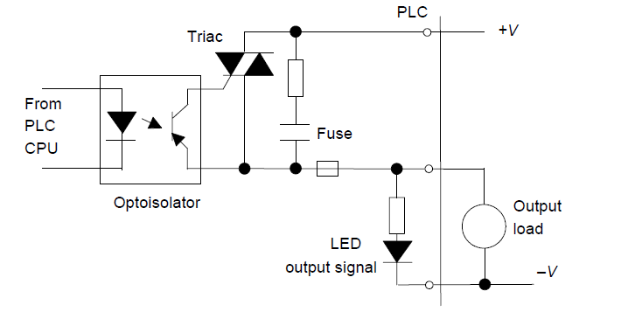

Slide 38
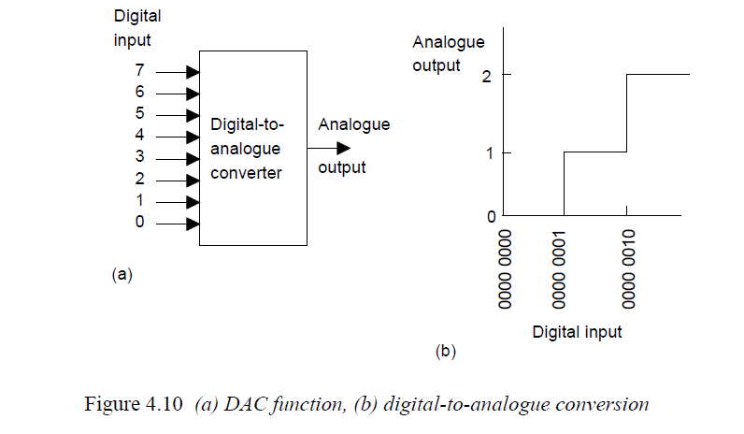
Demultiplexer

Slide 39
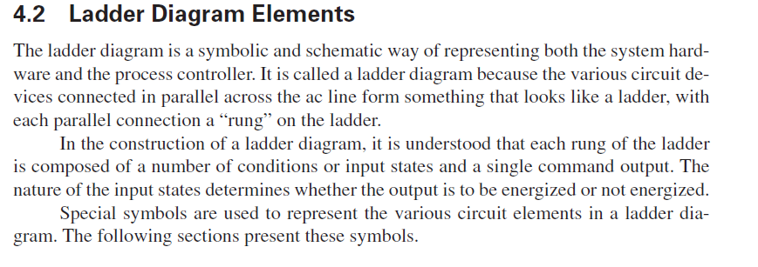
PLC: Ladder Diagrams

Slide 40
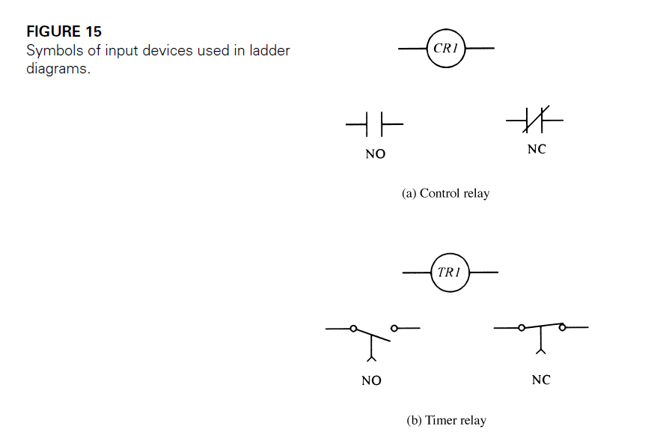
Symbols used in Ladder Diagram: Inputs

Slide 41
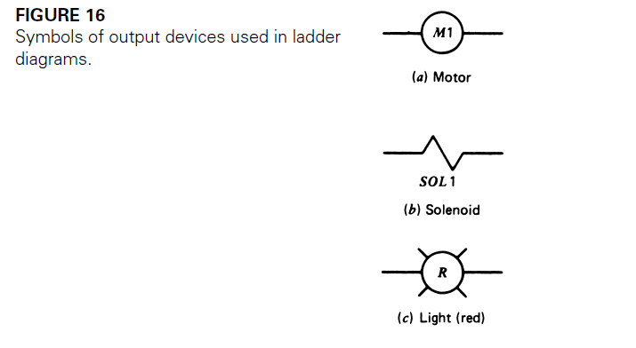
Symbols used in Ladder Diagram: Outputs

Slide 42
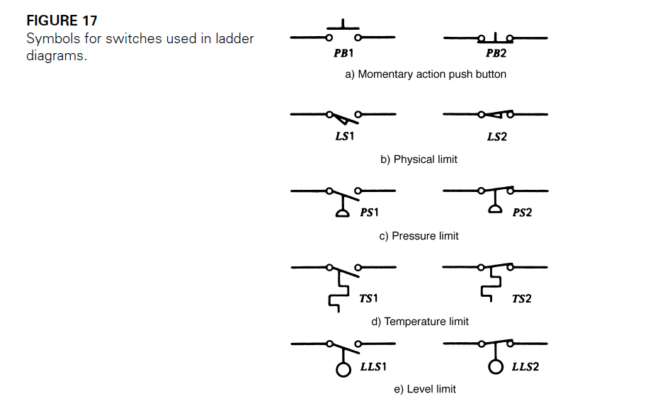
Symbols used in Ladder Diagram: Switches

Slide 43
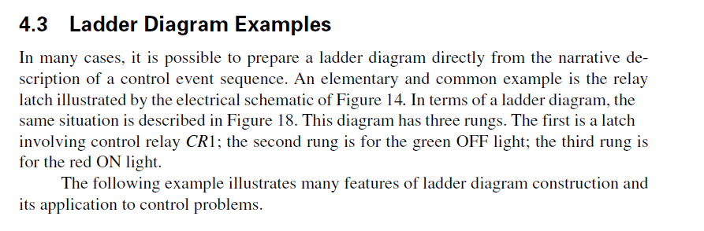
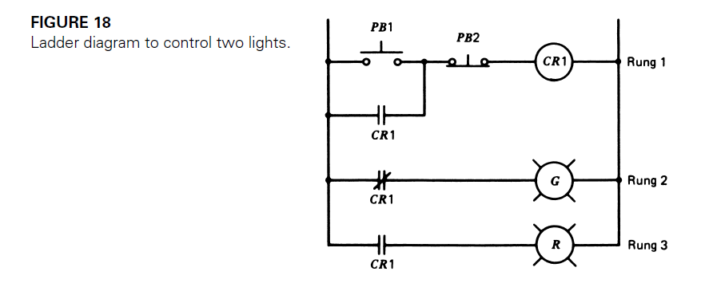

Slide 44
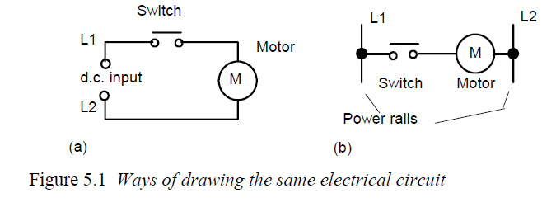
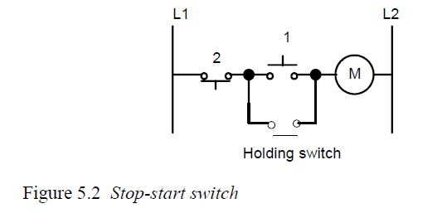

Slide 45
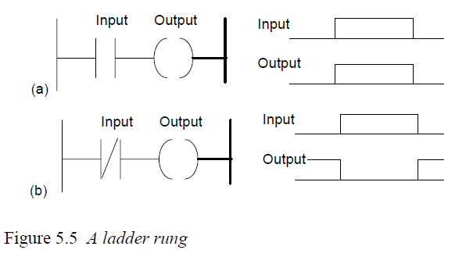

Slide 46
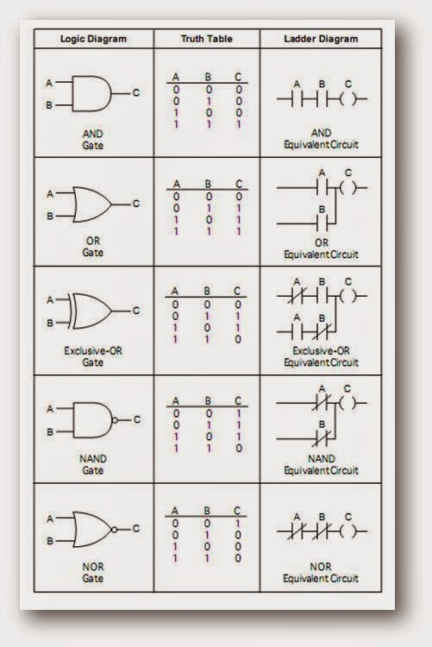
Logic Gates

Slide 47

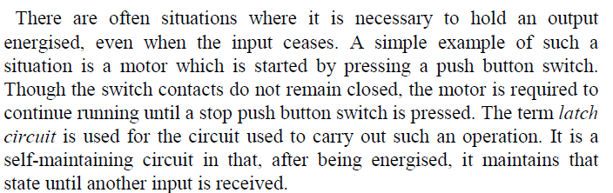
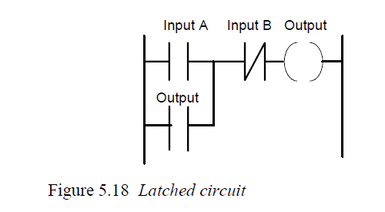

Slide 48



Slide 49



Slide 50



Slide 51


Slide 52

EX: PLC Mixer Process Control Problem
Mixer motor to automatically stir the liquid in the vat when the temperature and
pressure reach preset values
Alternate manual pushbutton control of the motor to be provided
The temperature and pressure sensor switches
close their respective contacts when conditions reach their preset values

Slide 53

Process Control Relay Ladder Diagram
Motor starter coil is energized when both the pressure and temperature switches are closed or when the manual pushbutton is pressed

Slide 54

PLC Input Module Connections
The same input field devices are used
These devices are wired to the input module according to the manufacturer’s labeling scheme

Slide 55


PLC Output Module Connections
Same output field device is used and
wired to the output module
Triac
Triac switches motor
ON and OFF in accordance with the control signal from the processor

Slide 56

PLC Ladder Logic Program
The format used is similar to that of the hard-wired relay circuit

Slide 57
PLC Ladder Logic Program
The symbols represent instructions

Slide 58
PLC Ladder Logic Program
The numbers represent addresses

Slide 59
PLC Ladder Logic Program
I/O address format will differ, depending on the PLC manufacturer. You give each input and output device an address. This lets the PLC know where they are physically connected

Slide 60

Entering And Running The PLC Program
To enter the program into the PLC, place the processor in the PROGRAM mode and enter the instructions one-by-one using the programming device
To operate the program, the controller is placed in the RUN mode, or operating cycle

Slide 61

PLC Operating Cycle
During each operating cycle, the controller examines the status of input devices, executes the user program, and changes outputs accordingly
The completion of one cycle of this sequence is called
a scan. The scan time, the time required for one full cycle, provides a measure
of the speed of response of the PLC

Slide 62



PLC Operating Cycle
Each
can be though of as a set of normally open contacts
The
can be considered to represent a coil that, when energized, will close a set of contacts.

Slide 63
PLC Operating Cycle
Coil O/1 is energized when contacts I/1 and I/2 are closed or when contact I/3 is closed. Either of these conditions provides a continuous path from left to right across the rung that includes the coil.

Slide 64

Modifying A PLC Program
Relay ladder diagram for modified process.
The change requires that the manual pushbutton
control should be permitted to operate at any pressure but not unless the specified temperature setting has been reached.

Slide 65
Modifying A PLC Program
Relay ladder diagram for modified process.
If a relay system were used, it would require some rewiring of the system, as shown, to achieve the desired change.

Slide 66

Modifying A PLC Program
PLC ladder logic diagram for modified process.
If a PLC is used, no rewiring is necessary! The inputs and outputs are still the same.
All that is required is to change the PLC program

Slide 67


PLCs Versus Personal Computers
Same basic architecture
PLC
Operates in the industrial environment
Is programmed in relay ladder logic
Has no keyboard, CD drive, monitor, or disk drive
Has communications ports, and terminals for input and output devices
PC
- Capable of executing several programs simultaneously, in any order
- Some manufacturers have software and interface cards available so that a PC can do the work of a PLC

Slide 68

PC Based Control Systems
Advantages
Lower initial cost
Less proprietary hardware and software required
Straightforward data exchange with other systems
Speedy information processing
Easy customization

Slide 69


PLC Size Classification
Criteria
Number of inputs and outputs (I/O count)
Cost
Physical size
Nano PLC
Smallest sized PLC
Handles up to 16 I/O points
Micro PLC
- Handles up to 32 I/O points

Slide 70


PLC Size Classification
Allen-Bradley SLC-500 Family
- Handles up to 960 I/O points
Allen-Bradley PLC-5 Family
- Handles several thousand I/O points

Slide 71

PLC Specifications

Slide 72

PLC Instruction Set
Other Programming Methods
The instruction set for a particular PLC type lists the different types of instructions supported.
An instruction is a command that will cause a PLC to perform a certain predetermined operation.

Slide 73
Typical PLC Instructions
XIC (Examine ON) . . . . . . . Examine a bit for an ON condition XIO (Examine OFF) . . . . . . Examine a bit for an OFF condition OTE (Output Energize) . . . . Turn ON a bit (non retentive)
OTL (Output Latch) . . . . . . Latch a bit (retentive) OTU (Output Unlatch) . . . . Unlatch a bit (retentive)
TOF (Timer Off-Delay) . . . . . Turn an output ON or OFF after its
rung has been OFF a preset time interval
TON (Timer On-Delay) . . . . Turn an output ON or OFF after its
rung has been ON for a preset time interval
CTD (Count Down) . . . . . . . Use a software counter to count down
from a specified value
CTU (Count Up)
. . . . . . . . . Use a software counter to count up to a specified value

Slide 74
THANK YOU

